Slide 1

Participants in the Economy

Slide 2
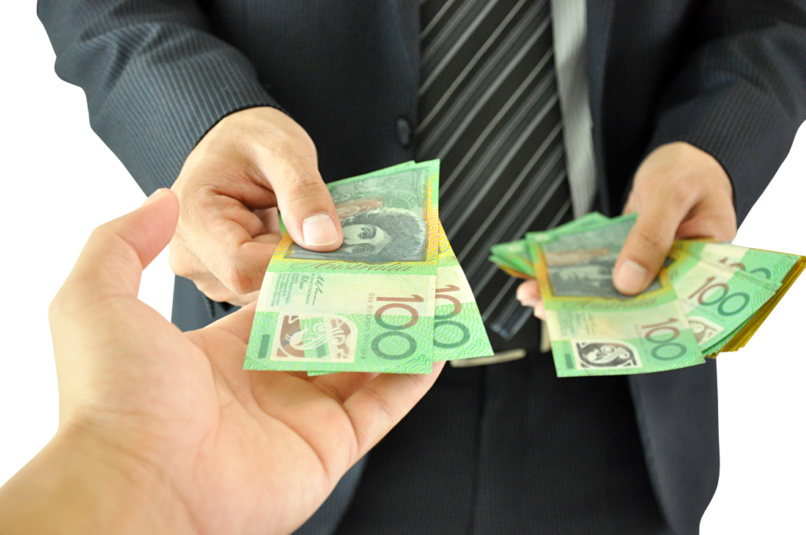
The major participants in the Australian economy include the household sector, the business sector, the financial sector and the government sector.

Slide 3
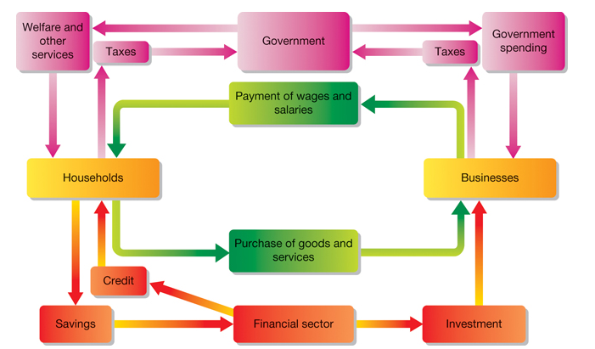
It flows between households, businesses, banks and the government in the Australian economy
Where does our money go?
https://www.youtube.com/watch?v=mN5HPJYJzus

Slide 4

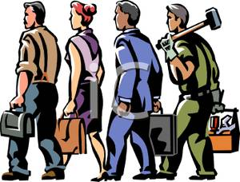

The Household Sector
The household sector is a term used by economists to refer to the total of all consumers in the economy. Every person in the economy is a consumer — we all acquire goods and services to satisfy our needs and wants.
The household sector provides the labour required by the business sector to produce those goods and services.
When buying goods and services, we are part of the household sector. When at work, we are part of the business sector.

Slide 5
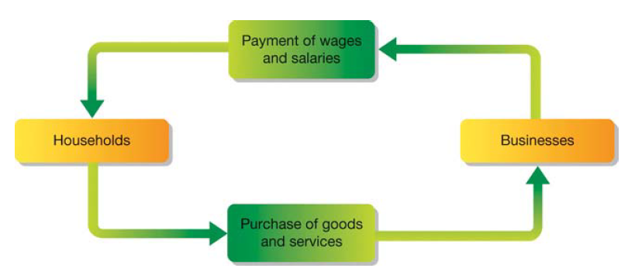
The Household Sector
Members of the household sector make decisions about the particular goods and services they desire to satisfy their needs and wants. The amount of goods or services that consumers are willing and able to purchase at a particular point in time is known as consumer or household demand.
If businesses wish to be successful, they need to respond to this demand. A business producing goods or services that do not meet consumer demand is likely to fail.

Slide 6


The Business Sector
The business sector is made up of a large number of producers, all seeking to provide goods and services to satisfy the needs and wants of households. In order to do so, businesses make use of resources. These are sometimes also called factors of production.

Slide 7


The Business Sector Resources can fit into four categories:
Land - refers to all the raw materials and other natural resources that go into the production of goods and services. | Labour - the human skills and effort required in the production process.
Capital - all the equipment (machinery, buildings, tools) used by human labour in the process of production. | Enterprise - Enterprise is the ability to recognise the demand for new goods or services, and to start up a new business or expand an existing business to attempt to satisfy that demand.

Slide 8

The Financial Sector
First, watch the video on why money was created.
Household and business sectors rely on a functioning financial sector. As the name suggests, the financial sector is concerned with money. Lets examine the functions of money in our economy.
Money performs the following four very important functions in our economic system:
https://www.youtube.com/watch?v=J7hNOt2Y0J8
Medium of exchange — money allows us to pay for things because it is accepted by everyone in our economy. Employees exchange their labour for money, and businesses accept money in exchange for the goods and services they supply.
Measure of value — money allows us to put a price on the goods and services we exchange. The price is a measure of what we believe the goods or services to be worth when compared to other goods and services.
Store of value — money allows us to save our income or wealth for spending at a later date because it holds its value.
Standard of deferred payment — money allows us to purchase goods and services on credit with both buyer and seller knowing exactly how much has to be paid at a later date.

Slide 9
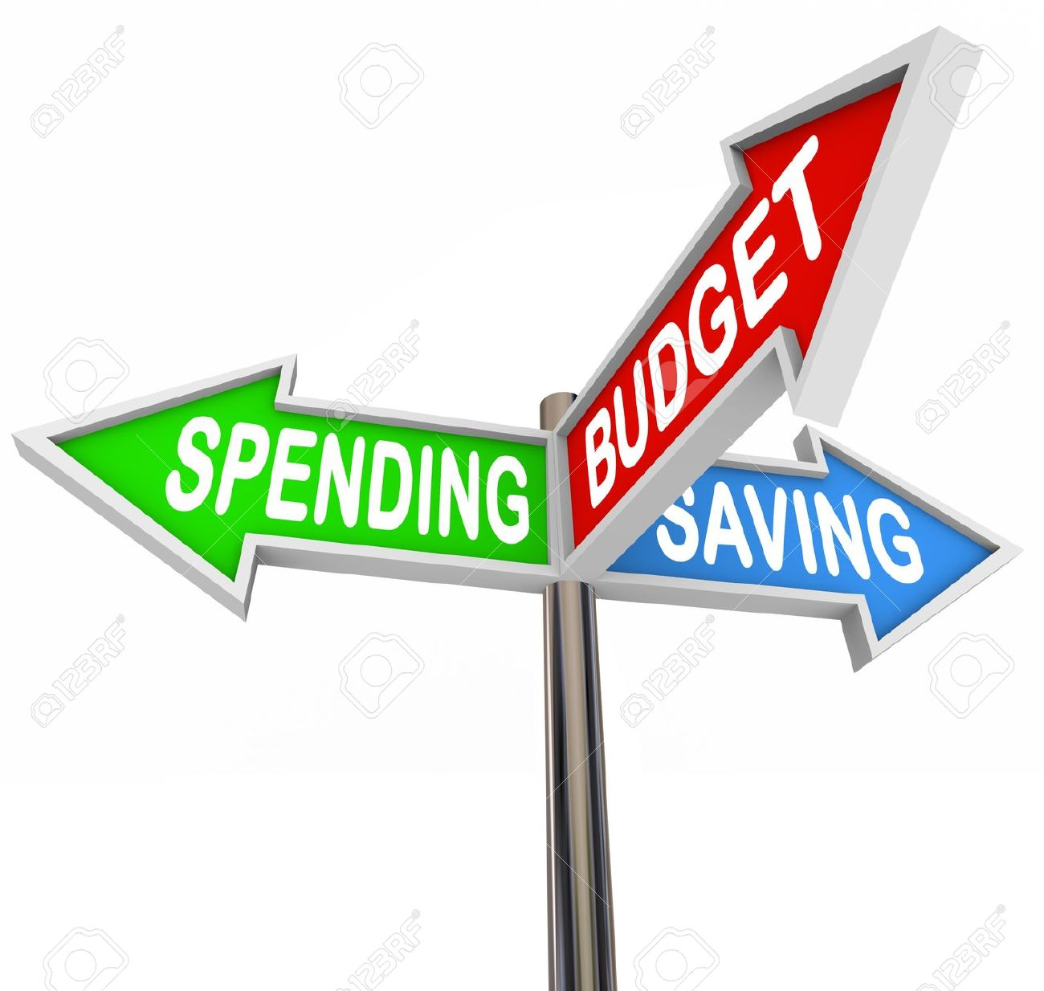
The Government Sector
Another significant participant in our economic system is government. Households and businesses pay money to government in the form of taxes and receive certain goods and services from the government. The government plays an important role in the economy for a number of reasons:
1. The amount of money taken by the government in taxes can affect the amount of money consumers have available to spend on goods and services. Levels of taxation affects households and businesses.
2. Money collected in taxes can be used to provide welfare payments in the form of pensions and unemployment benefits. Such payments allow many people to purchase more goods and services as consumers, thereby providing more income to businesses and creating more jobs as businesses grow.
3. Money collected in taxes from households and businesses can be used to provide essential services such as roads, schools and hospitals. This helps businesses to grow and employ more people.

